Slide 2
I am going to see a live theater show called “The Snowy Day And Other Stories by Ezra Jack Keats.” at the Long Island Children’s Museum Theater. When I get to the Museum I will see a big sign on the building that says “LICM.”

Slide 3
We will go inside the building through big yellow doors that have a sign that says “Long Island Children’s Museum.”

Slide 4
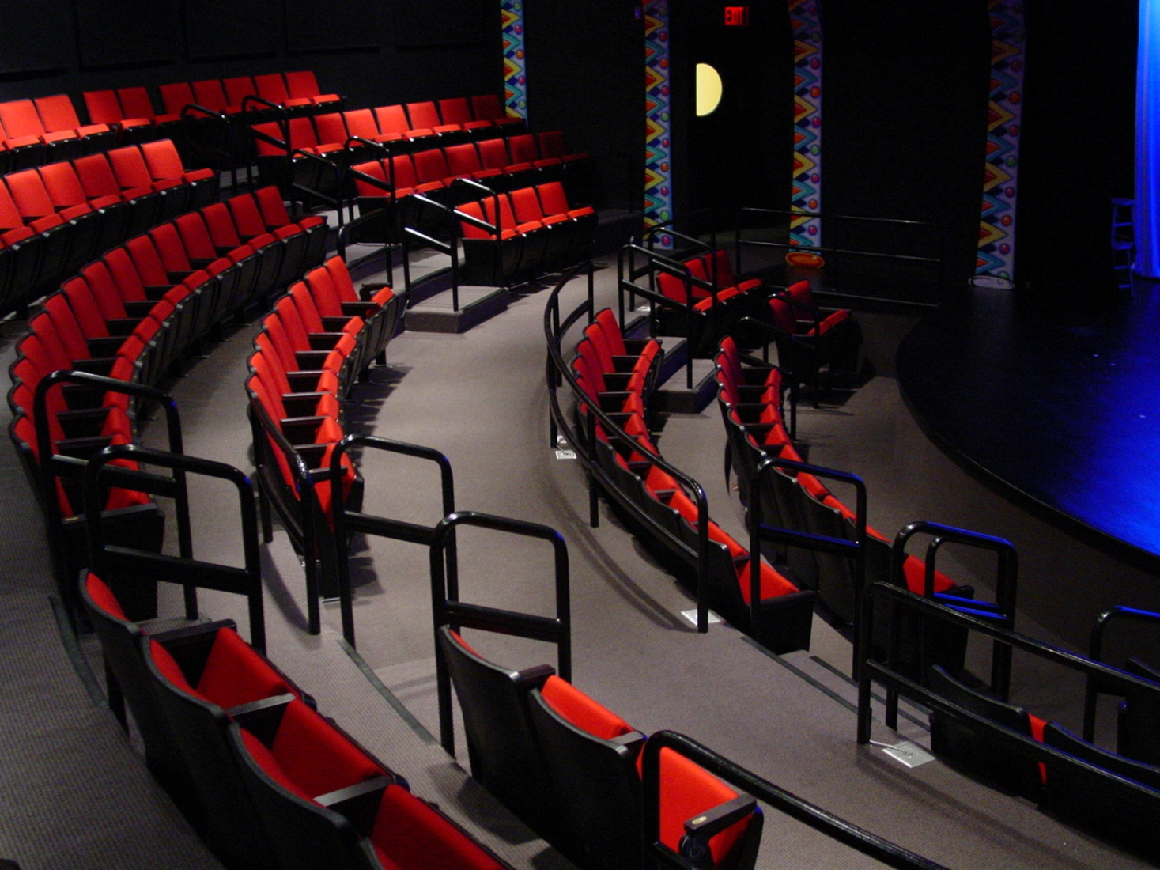
Going to the theater is a little like watching a movie or TV. But the people in a show are right there on stage. They are called actors. The actors will tell the stories in by talking, singing, dancing and moving around the stage and audience. There will also be live music!

Slide 5
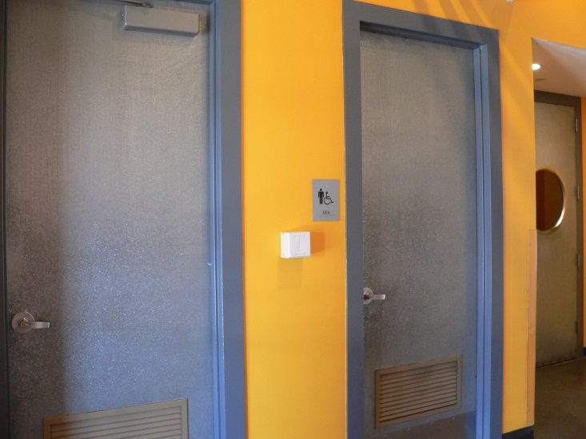
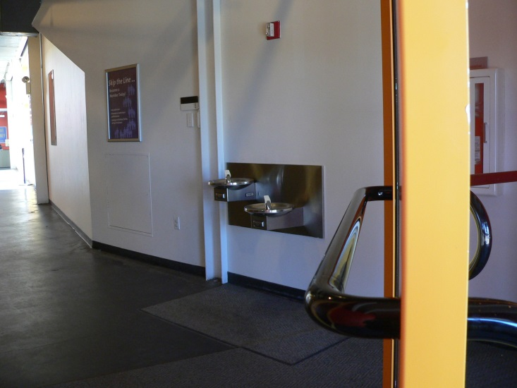
When we get inside we will see the water fountains and the bathrooms. I can ask an adult to help me if I need a drink of water or need to use the bathroom.

Slide 6
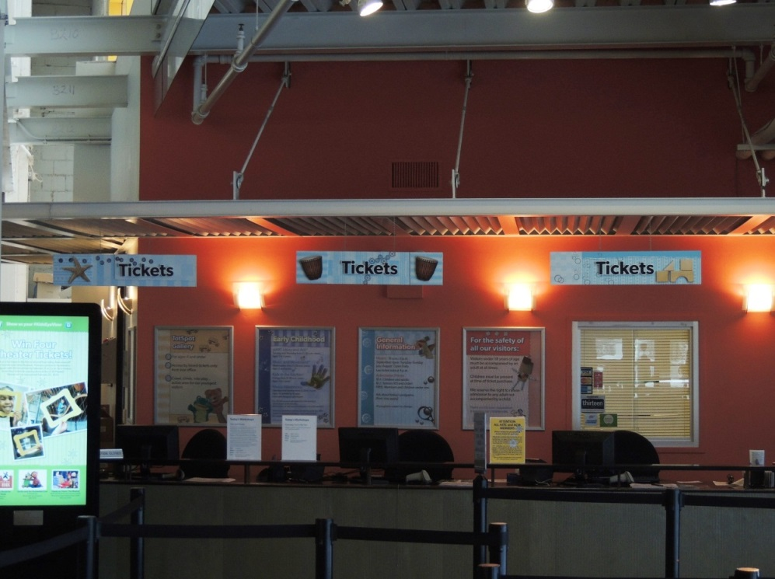
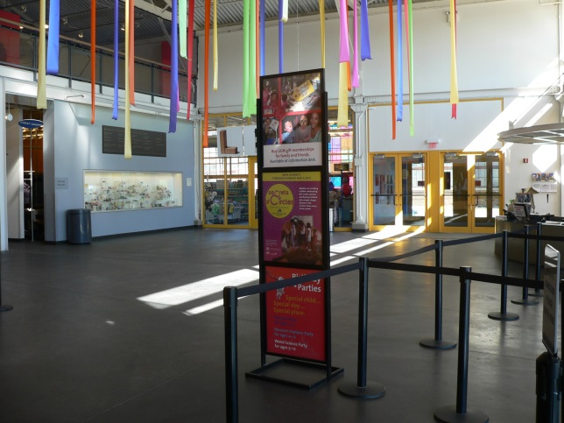
Then we will walk passed the back doors of the Theater and into the lobby. The lobby will look like this.

Slide 7
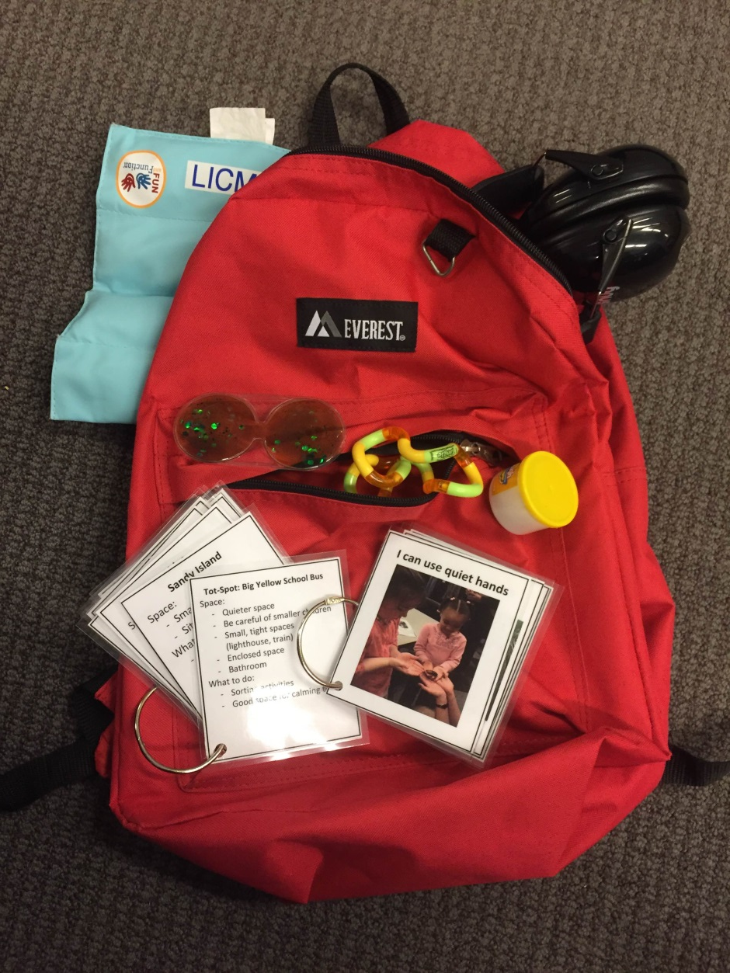
If I am feeling overwhelmed we can borrow the Sensory Backpack which will have a weighted lap-pad, headphones and other things to help me stay relaxed.

Slide 8
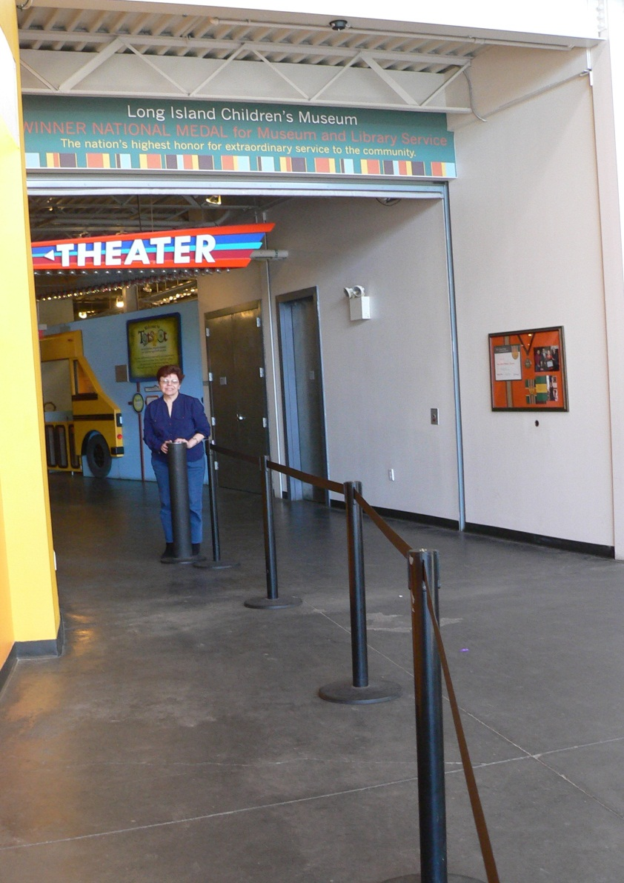
When we have our tickets we will stand in line near the big sign that says “Theater.” While we are waiting our turn to go inside, I will stand nicely and quietly.

Slide 9
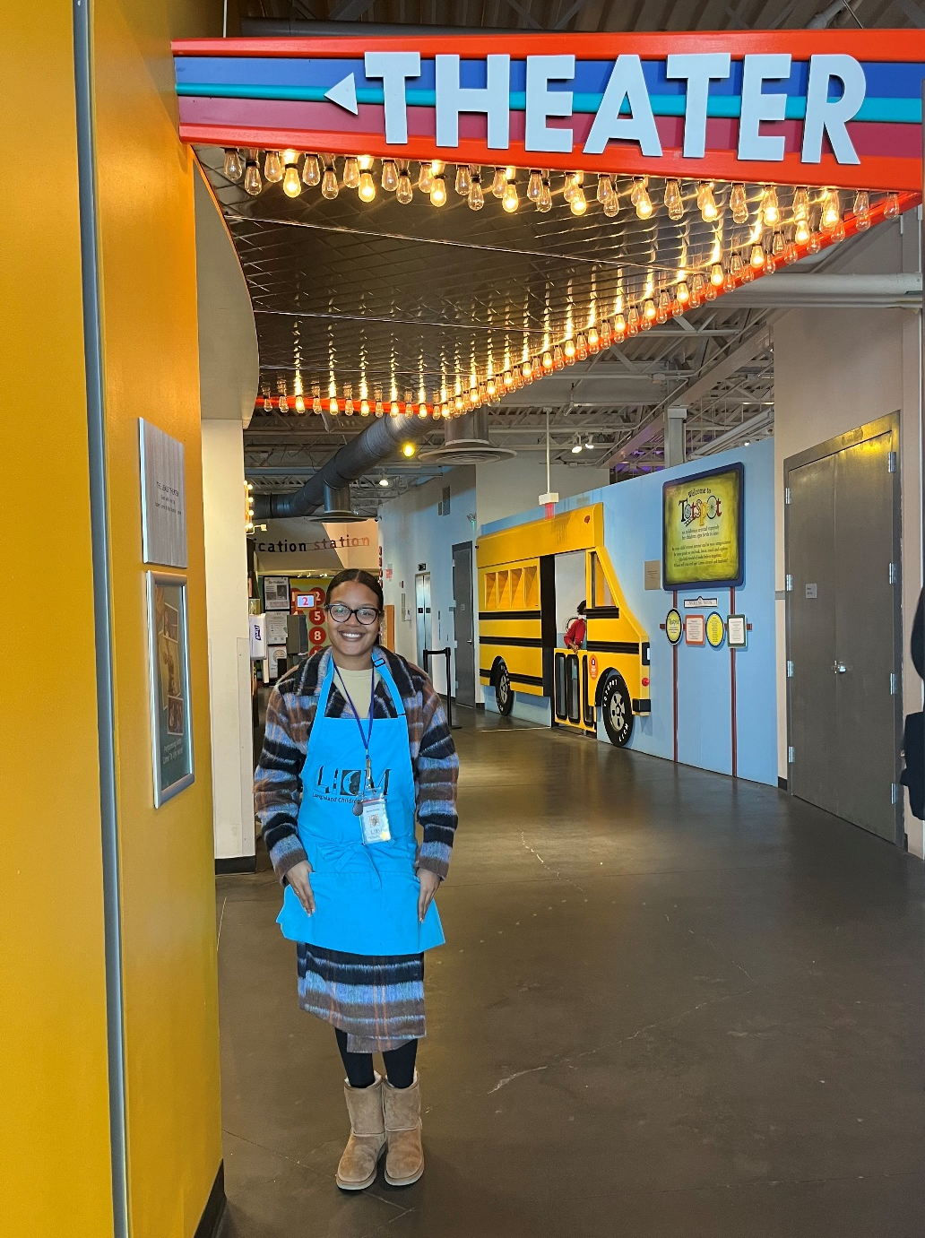
When it is our turn to go into the Theater, a person called an usher will look at our tickets. The usher will be wearing a blue apron with the letters “LICM.” We can sit wherever there is an available seat.

Slide 10
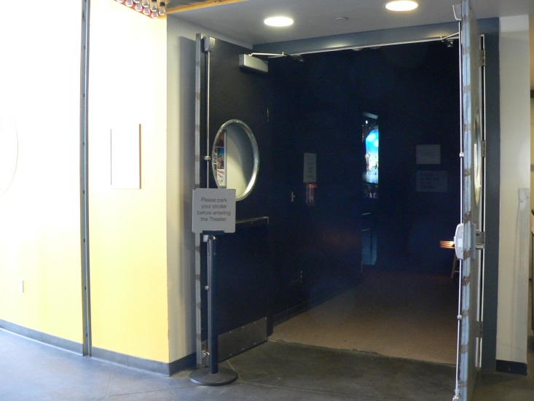
We will enter the Theater through big doors. This is what the theater doors look like.

Slide 11
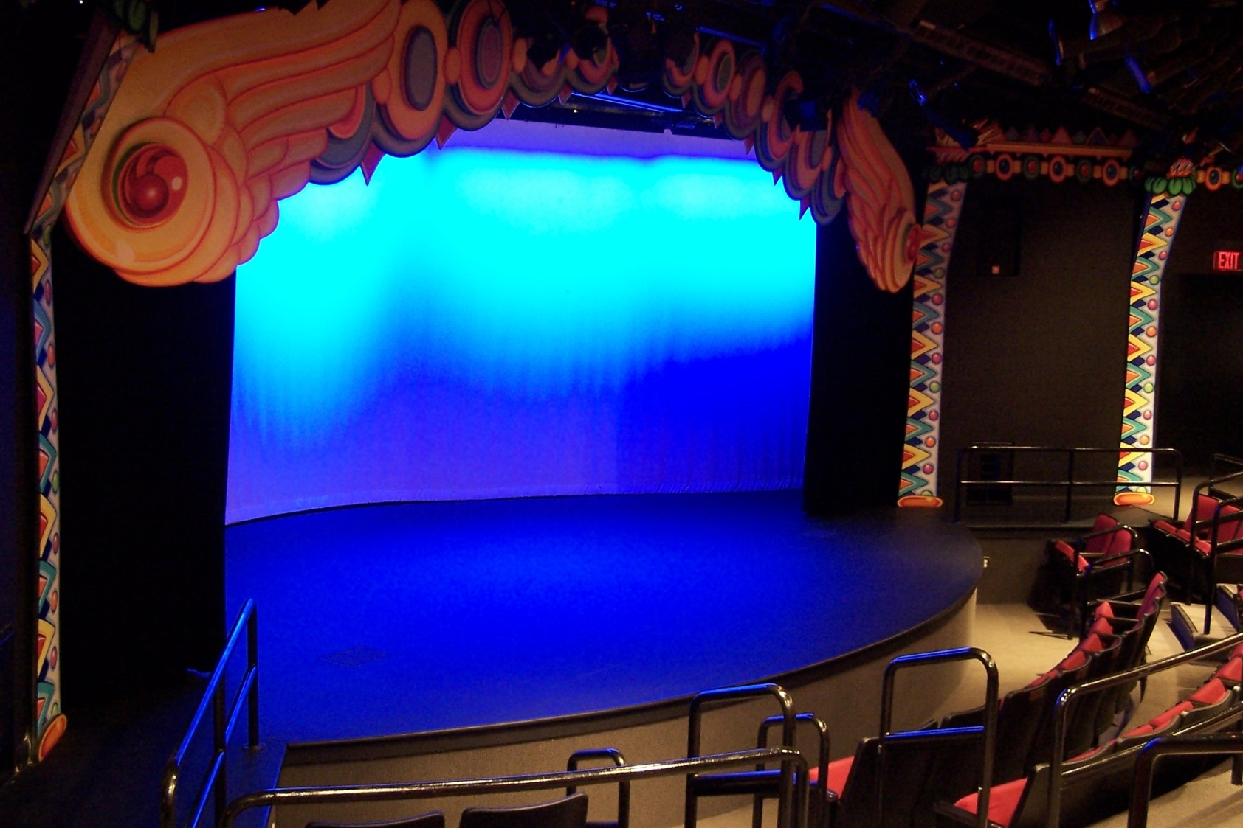
The theater is very colorful with bright paintings all around the stage and on the walls.
Notes:
Add if character page is availalbe

Slide 12
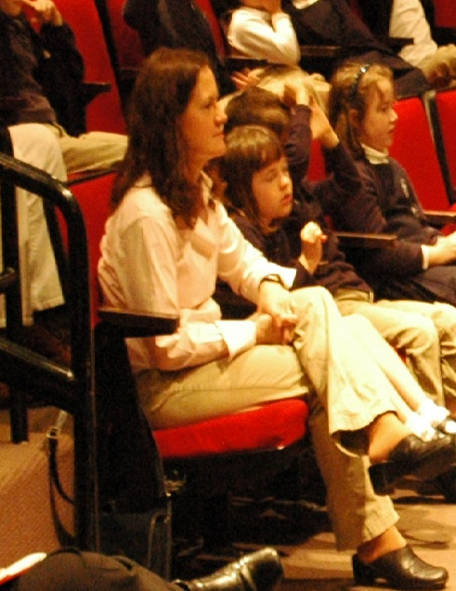
When we get to our seats, I will sit down nicely and wait for the show to start. If I have any questions, I can ask an adult, or one of the ushers.
Sometimes it’s hard to wait. I can play with my fidget or hold hands with my adult.

Slide 13
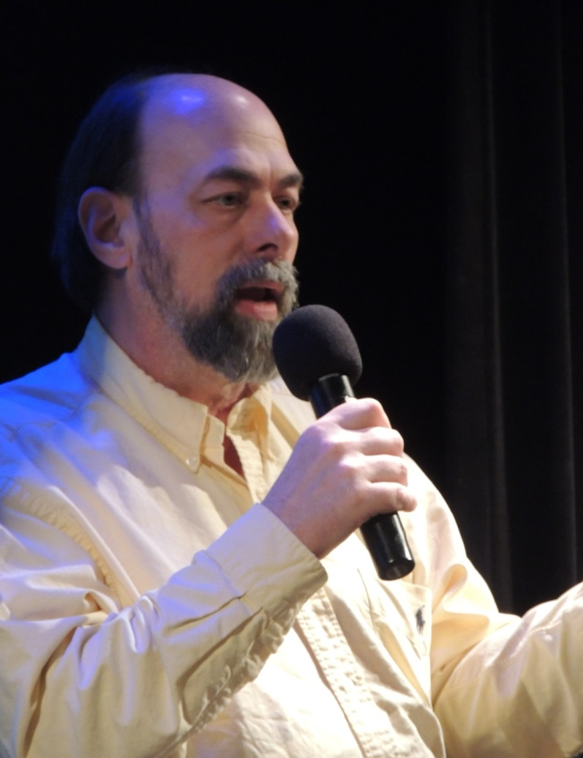
When it is time for the show to start, someone will walk on stage and talk to the audience. Everyone in the theater will get quiet. I will try to be as quiet as I can during the show so that I can hear everything.
Notes:
Add picture of Jim on stage announcement

Slide 14
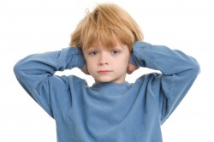
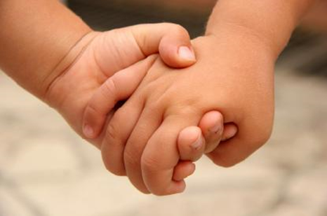
Then the actors will come on to the stage, and the music will start playing. They will start the show by introducing themselves. Sometimes the lights will get brighter but they will always stay on. If any sounds or music are too loud during the show, I can cover my ears, wear my headphones or hold hands.

Slide 15
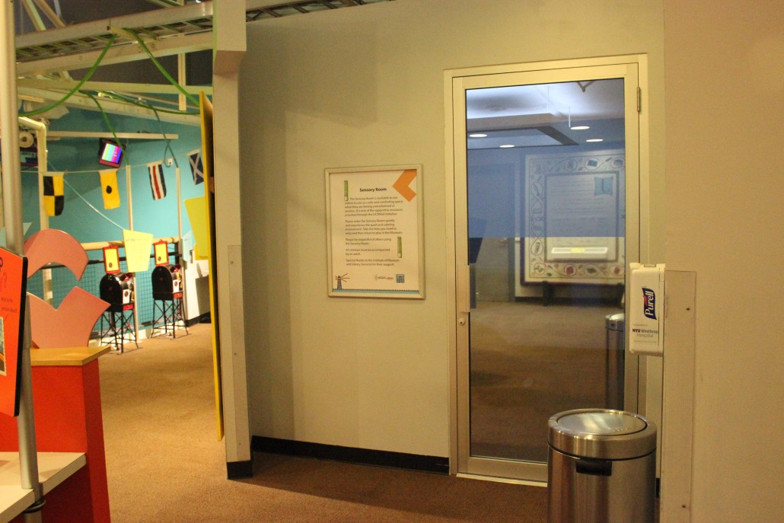
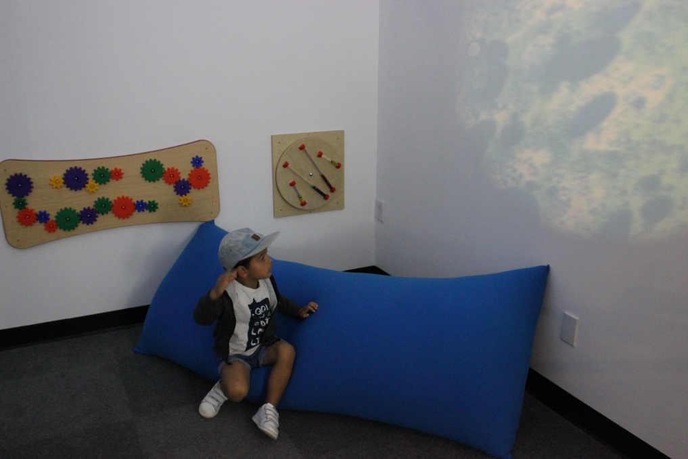
If I am feeling overwhelmed or anxious I can go to the Sensory Room located on the second floor of the Museum. In the Sensory Room I can use some of the tools to help me feel calm. I can stay in the Sensory Room until I am ready and then I can go back to the theater to watch the show.
Since the museum will be open I can also play in the exhibits for a few minutes to get the wiggles out until I am ready to watch the show again.

Slide 16
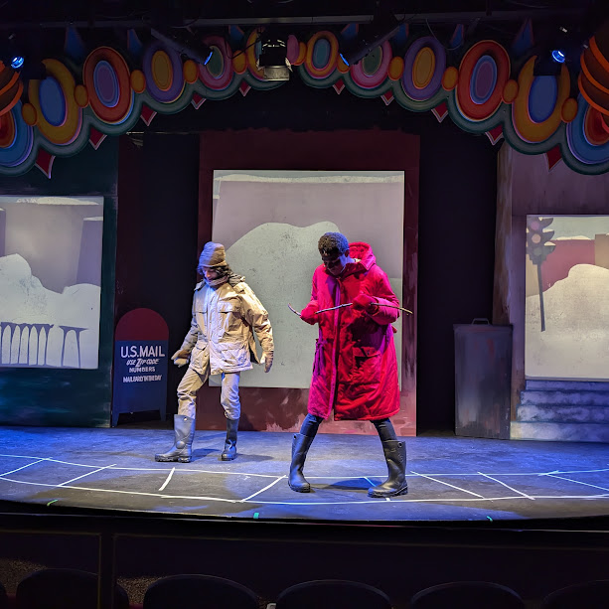
In the show the actors will be wearing costumes so they can pretend to be a character. Sometimes there will be actors on stage using puppets to tell the story of the play.

Slide 17
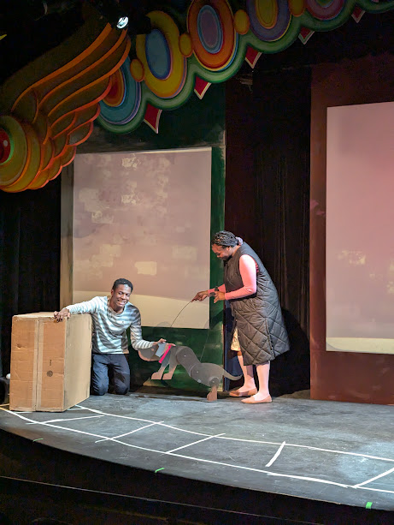
Sometimes the actors will leave the stage and come into the audience to tell part of the story. The actors may come close to me but I will stay in my seat.

Slide 18
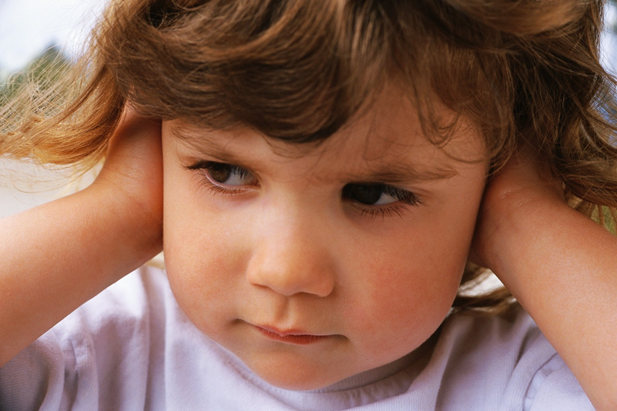
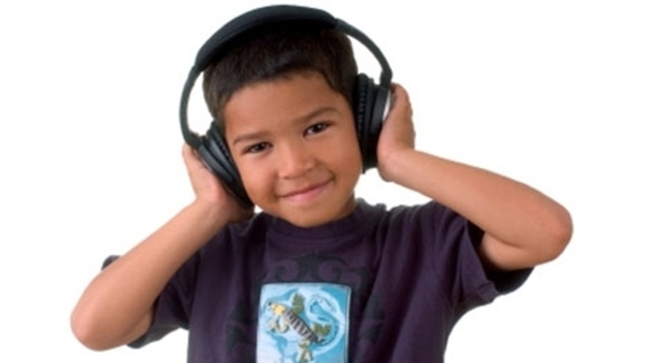
I will have a lot of fun at the show! There will be a lot of singing and dancing. Sometimes it might be too loud for me. I can cover my ears, wear my headphones, or hold a hand. I know that even though the singing and instruments are loud and can feel scary, none of these noises can hurt me.
Sometimes I may think the show is a little scary. If I am scared, I can cover my ears, hold a hand or hug someone sitting next to me.

Slide 19
If I need to get a drink during the show or want to go to the bathroom, I can tell the adult who is with me.
Notes:
Add pix of usher

Slide 20
Sometimes during the show, some people will clap. Clapping is nice because it tells the actors you liked their song or story. If I want to clap, I can. I don’t have to clap if I don’t want to. I know that even though the clapping can be loud and can feel scary, none of the noise can hurt me.
Notes:
Replace with pix of kids “waving” rather than clapping ; remove pixs of indiv kids used previousl

Slide 21
After the show is over, the actors will stay to say hello and I might be able to meet them! I should wait until my adult tells me it is okay to say hi to the actors.

Slide 22
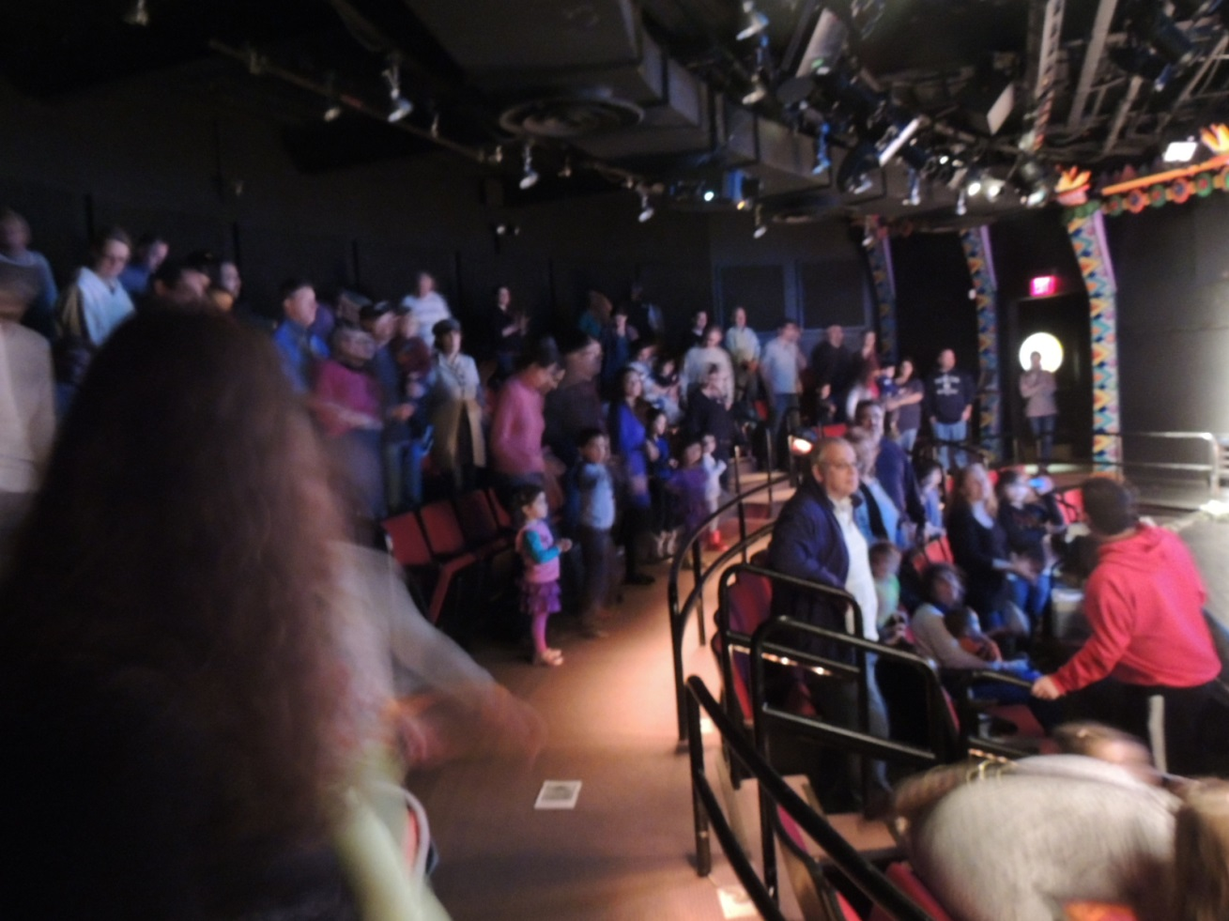
It will be crowded when people are leaving the Theater after the show. I will wait quietly until it is our turn to leave. I will stay close and hold the hand of the person I am with.

Slide 23
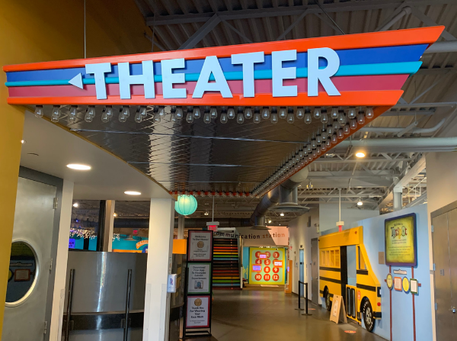
Going to the theater is lots of fun. I am very happy and excited to go to see “The Snowy Day And Other Stories by Ezra Jack Keats.” After the play is over I can go and play in the Museum with my adult.

